Slide 1
PowerApps ALM using Managed Solutions
Notes:
The final module examines the challenges and best practices for application lifecycle management (ALM) with PowerApps and the Power platform. Students will first learn the simplest style of ALM which includes publishing, sharing and versioning apps within a single environment. Next, the module demonstrates how to individually export and import canvas apps and flows to move business solutions between environments. The modules concludes with an examination of the core PowerApps concepts of publishers and managed solutions and explains the best practices for packaging, distributing and versioning business solutions built on the PowerApps platform.

Slide 2
Agenda
Understanding Environments and DLP Policies
Single-environment ALM Strategies
Exporting and Importing Canvas Apps and Flows
Understanding Publishers and Solutions
Exporting and Importing Solutions
ALM using Managed Solutions

Slide 3
What is an Environment?
Environment is container for PowerApps, Flow and CDS database
Each environment and its resources exist within a geographic region
Environment resources include PowerApps, Flows and CDS database
Environment represents a governance and security boundary
Every tenant is provisioning with a default environment
New environment can be provisioned with or without a CDS database
Tenant A – Acme Corp
Tenant B – Mega Corp
Default Environment
POC Environment
Default Environment
Production Environment
Dev Environment
PowerApps & Flows
PowerApps & Flows
PowerApps & Flows
PowerApps & Flows
PowerApps & Flows
CDS
Database
CDS
Database
CDS
Database

Slide 4
PowerApps and Dynamics 365 Convergence
As of Dynamics 365 version 9
Dynamics 365 instance = PowerApps Environment with CDS DB
Tenant
Default Environment
Dynamics 365 Instance
PowerApps & Flows
PowerApps & Flows
CDS
Database

Slide 5
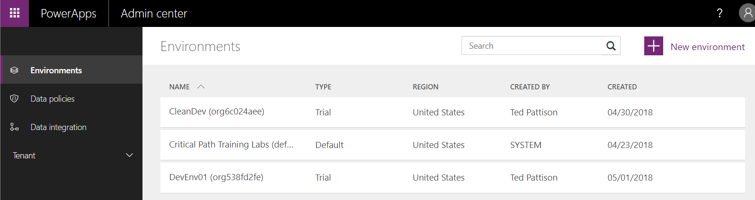
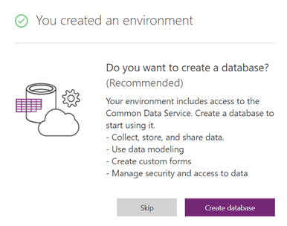
Managing Environments
Environments managed in PowerApps Admin Center
You can view existing environments and configure security and access
You can create new environments
When creating an environment, you can optionally include CDS database

Slide 6
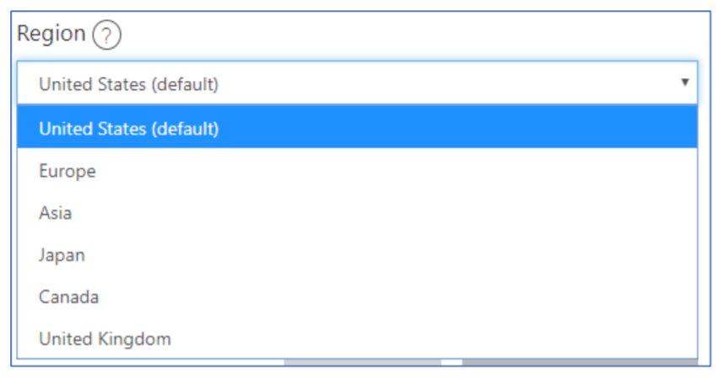
Environmental Regions
Environment is created in specific region
You can choose at create time
All app components and CDS DB stored in region
Issues to consider when creating environment
Create environment close to where users are located
Create environment in region required for data residency

Slide 7
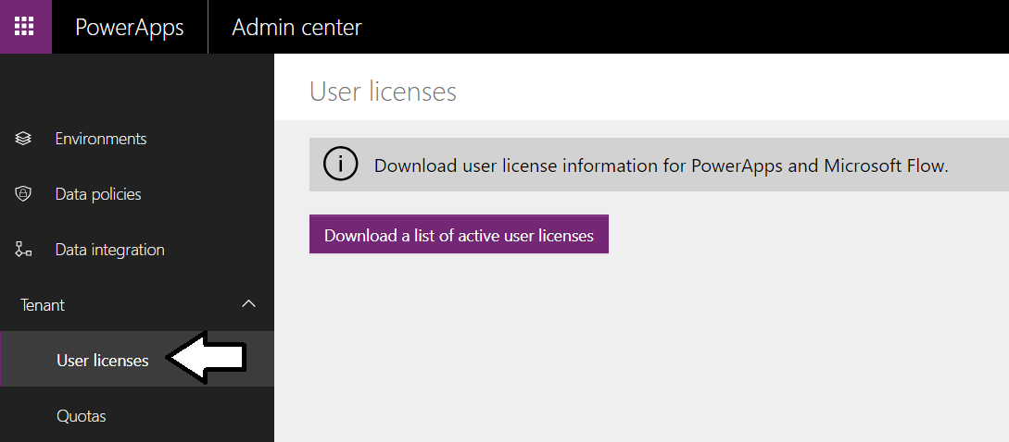
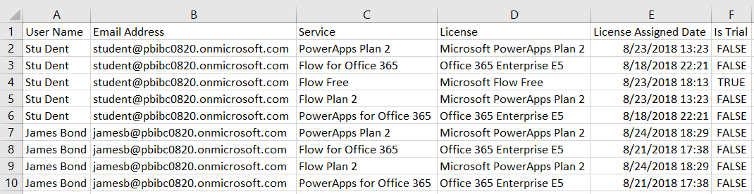
Viewing User Licenses

Slide 8
Types of Environments
Production
used for permanent work in an organization
Default
Special type of production environment
Sandbox
Non-production environment with environment reset feature
Trial
Temporary environment used to support short term testing
Developer
Environment created with the Community Plan license
Only supports a single user

Slide 9
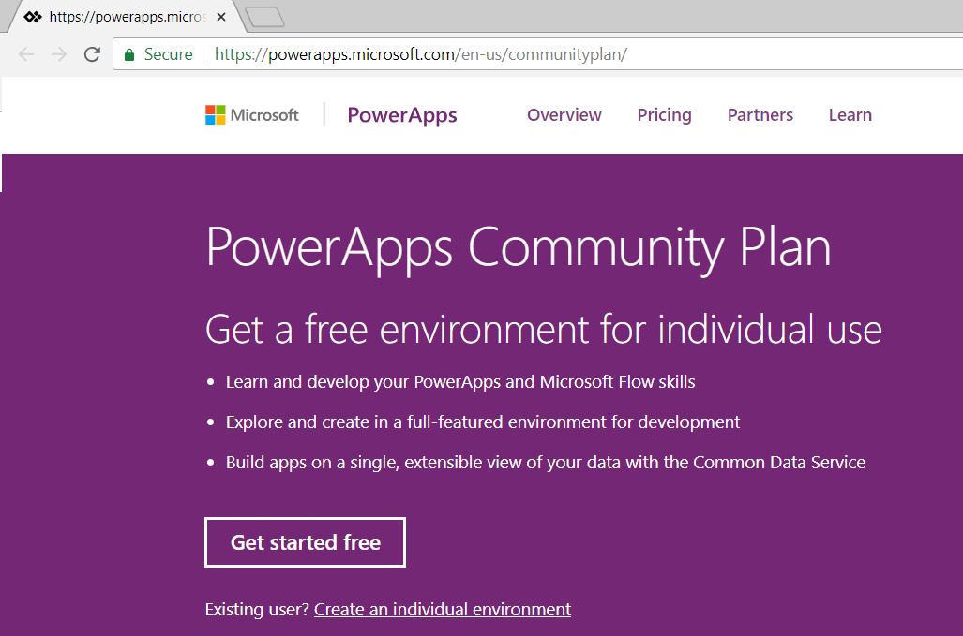
PowerApps Community Plan
PowerApps Community Plan offers free environment
Used to build solutions for PowerApps, Flows and CDS for Apps
Environment only allows for a single user
Sign up at https://powerapps.microsoft.com/en-us/communityplan/

Slide 10
Default Environment
Each tenant has default environment created in nearest Azure region
Default environment can’t be disabled or deleted
Default environment automatically adds all tenant users to maker role
You can't remove users from maker role of default environment
Default environment provides self-service app & flow building to all licensed users
Default environment does not yet support adding CDS database
Microsoft plans to eventually remove this limitation
Default environment currently only place you can create gateway
Therefore, default environment only place to access on-premises data
Microsoft plans to eventually remove this limitation

Slide 11
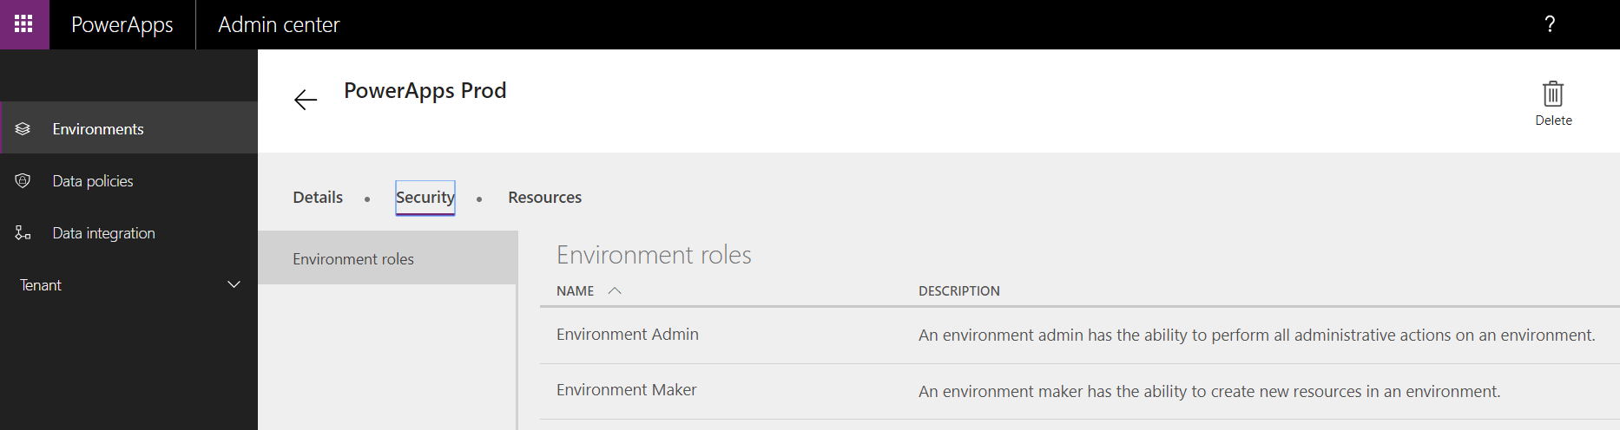
Environment Security Roles (No CDS)
Environment Administrator
Manage environment by adding/removing users
Creating the CDS database instance
Viewing and managing all resources in environment
Configure Data Loss Prevention policies
Environment Maker
Create and share canvas apps and flows
Create and share connections and custom connectors
Create gateways and build connections through gateways

Slide 12
CDS Security Roles
Environment requires CDS database to support…
Using and customizing standard entities
Creating custom entities
Creating model-driven applications
Environment with CDS database has different security model
Security model switches from Environment roles to CDS roles
Environment
without CDS database
Environmental Roles
(Maker/Admin)
Environment
with CDS database
Environmental Roles
(Maker/Admin)
Canvas App
Canvas App
Flow
Resource Permissions
(Owner/Contributor/User)
Flow
Resource Permissions
(Owner/Contributor/User)
Custom Connector
Custom Connector
CDS DB
CDS Roles
(Admin/Customizer/etc)

Slide 13
CDS Database Roles
System Administrator
Environment Admin promoted to System Administrator
Complete ability to customize and administer environment
Full read-write access to data in the database.
System Customizer
Full permission to customize the environment
Environment Maker
Create new apps, connections, gateways and flows
Common Data Service User
Ability to run apps but no ability to customize the system
This role is commonly copied to make custom security roles
Delegate
Special role to give a user permission to Act on behalf of another user

Slide 14
Agenda
Understanding Environments
Configuring Data Loss Prevention Policies
Sharing and Versioning Canvas Apps and Flows
Exporting and Importing Canvas Apps and Flows
Installing and Configuring an On-Premises Data Gateway
Packaging and Deploying Custom Solutions

Slide 15
Data Loss Prevention Policies
Data is critical in an organization’s success
It needs to be readily available for decision-making
Needs to be protected so it’s not shared with audiences that should not have access to the data
Data Loss Prevention (DLP) Policies
PowerApps provides a way to protect your data by providing the ability to create and enforce policies
You can define which consumer services/connectors specific business data may be shared with

Slide 16
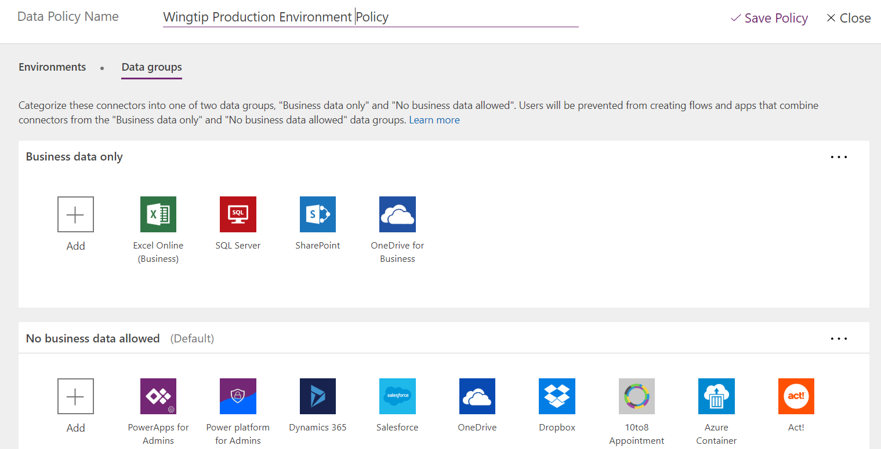
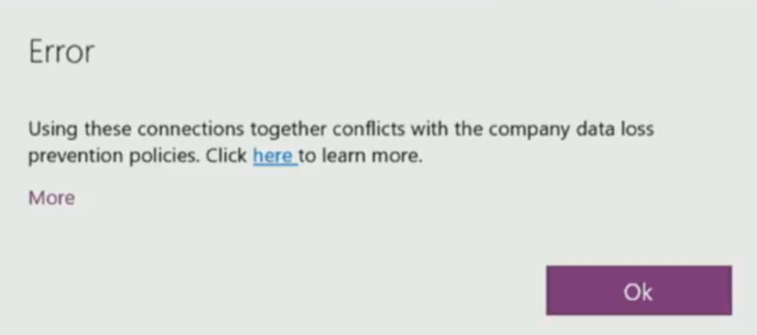
Data Loss Prevention (DLP) Policies
DLP policies determine of what connectors can be used
Allowed connectors configured as Business data only
Disallowed connectors classified as No business data allowed

Slide 17
Agenda
Understanding Environments
Configuring Data Loss Prevention Policies
Sharing and Versioning Canvas Apps and Flows
Exporting and Importing Canvas Apps and Flows
Installing and Configuring an On-Premises Data Gateway
Packaging and Deploying Custom Solutions

Slide 18
Configuring User Access to Apps & Flows
Sharing apps differs between these scenarios
App is a canvas app
App is a model-driven app
For canvas apps
Shared with users, Azure AD Groups or entire org
For model-driven apps
Shared by adding user to a CDS security role

Slide 19
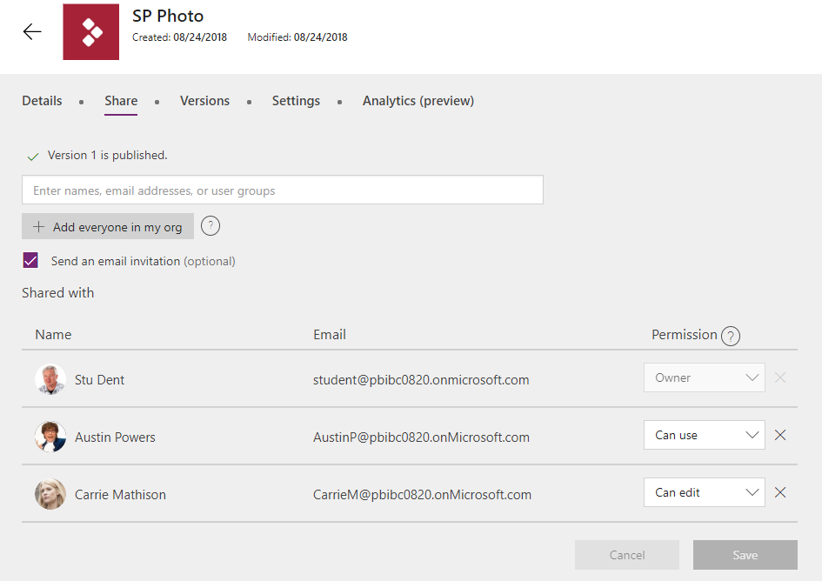
Sharing PowerApps
There are 3 level of app permissions:
Can Use: Users/groups can run the app but cannot edit or share the app
Can Edit: Users/groups can run, edit publish and share the app
Owner: Can Edit permission + ability to add other contributors

Slide 20
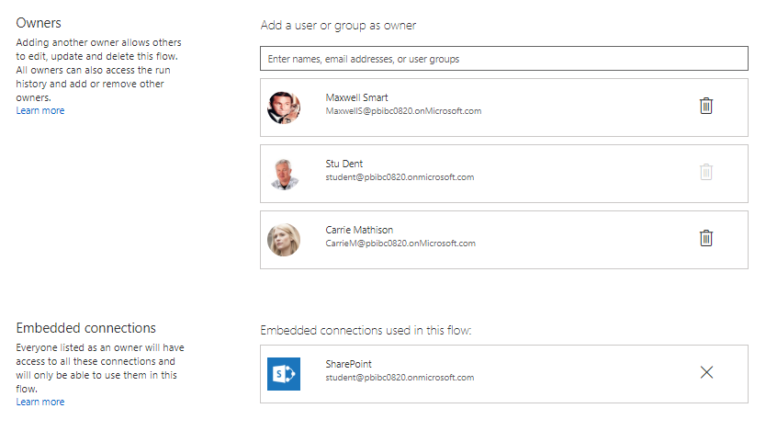
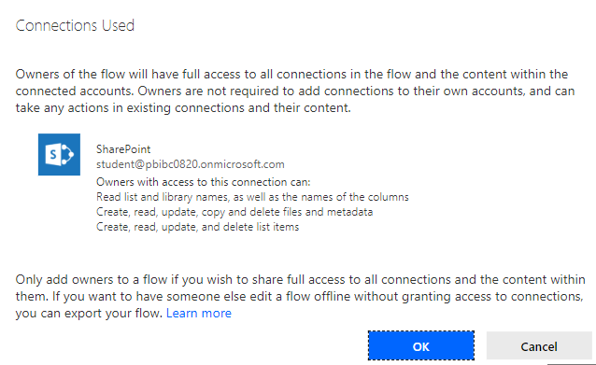
Sharing a Flow

Slide 21
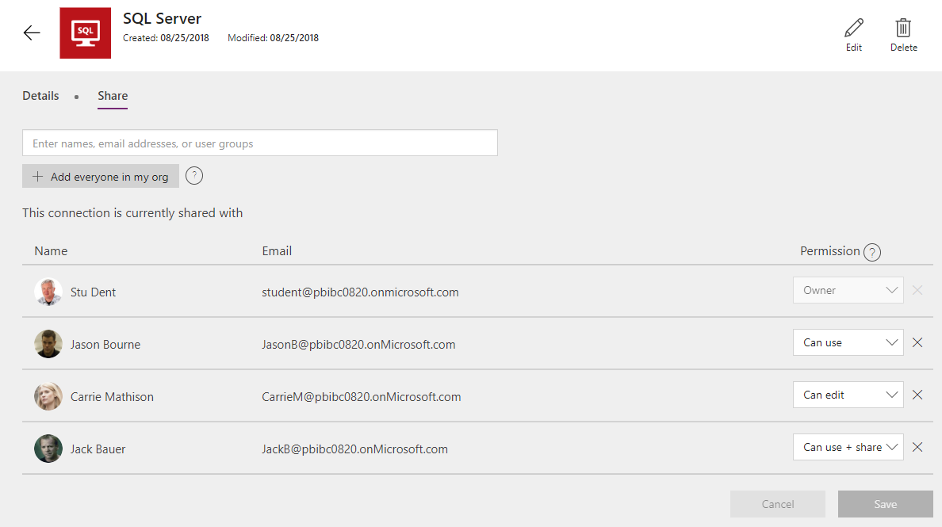
Sharing a Connection

Slide 22
Application Players
Application players used by consumers to run apps
Can be used to run both canvas apps or model-drive apps
Apps available to user discovered at web.powerapps.com
Dynamics 365 users see apps at home.dynamics.com
Application players available for install on mobile devices
Currently, there are separate apps for canvas and model-driven
Microsoft plans single app for canvas and model-driven in future

Slide 23
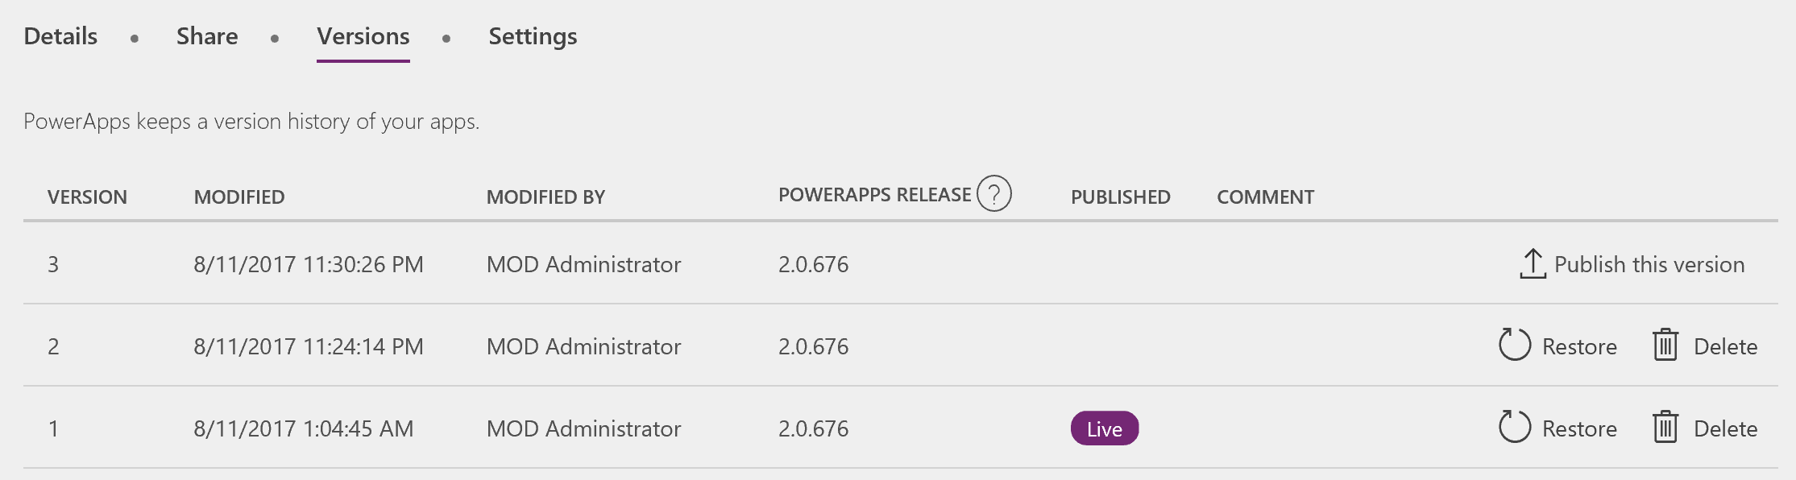
App Versioning in PowerApps
PowerApps keeps version history for apps saved to cloud
Accessible via https://web.powerapps.com
Restore, delete, and publish versions

Slide 24
Agenda
Understanding Environments
Configuring Data Loss Prevention Policies
Sharing and Versioning Canvas Apps and Flows
Exporting and Importing Canvas Apps and Flows
Installing and Configuring an On-Premises Data Gateway
Packaging and Deploying Custom Solutions

Slide 25
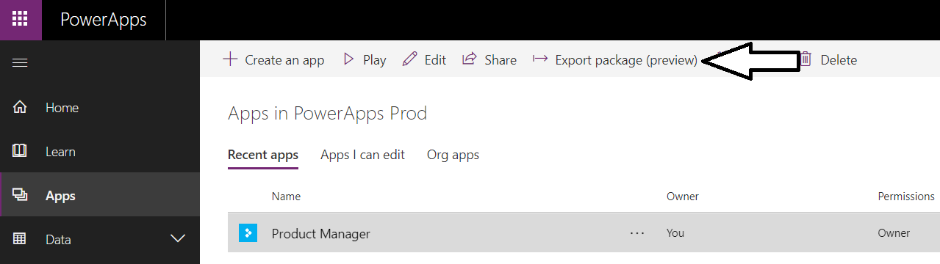
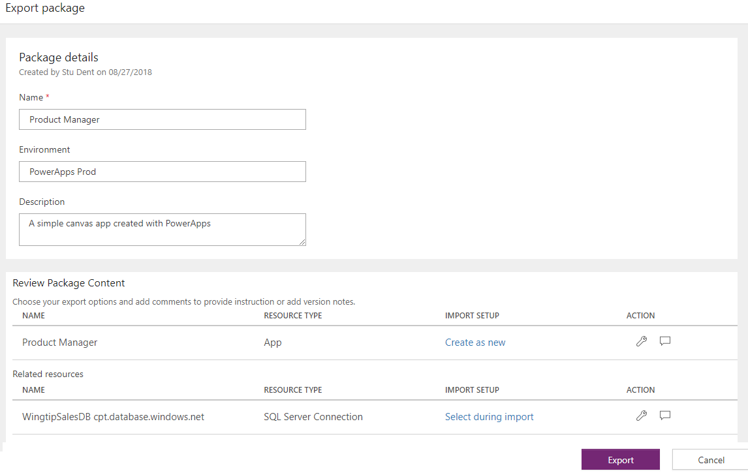

Exporting a Canvas App

Slide 26
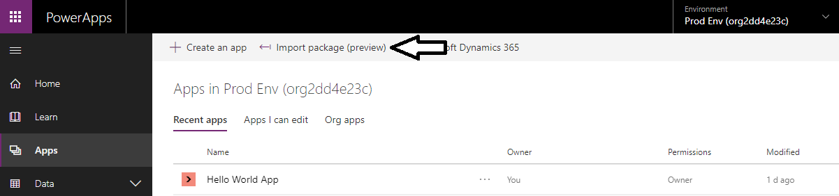
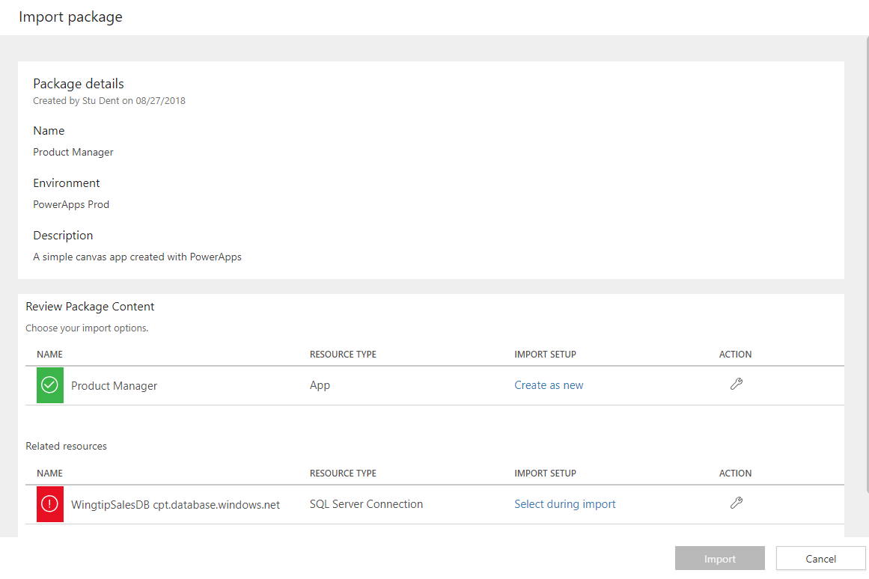
Importing a Canvas App

Slide 27
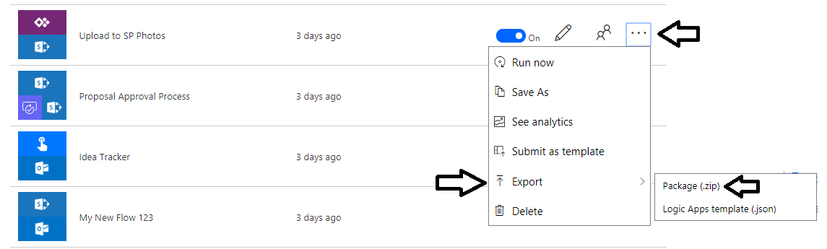
Exporting a Flow

Slide 28
Agenda
Understanding Environments
Configuring Data Loss Prevention Policies
Sharing and Versioning Canvas Apps and Flows
Exporting and Importing Canvas Apps and Flows
Installing and Configuring an On-Premises Data Gateway
Packaging and Deploying Custom Solutions

Slide 29
On-premises Data Gateway
Gateway used to connect to on-premises data sources
Runs on PC or server in local network
Used run on server joined to local Active Directory domain
Extracts data and returns it to Power BI service
Default Environment
Private Network with Active Directory Domain
PowerApps Solution
SQL Server Instance
Canvas App
PC or Server
SQL Database
Flow
Azure Service Bus
On-premises
Gateway
Read/Write
Connection1
Read/Write
SharePoint Farm
Connection2
Read/Write
Read/Write
SharePoint List

Slide 30
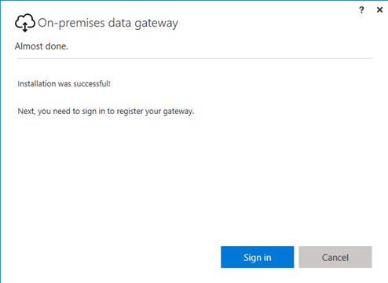
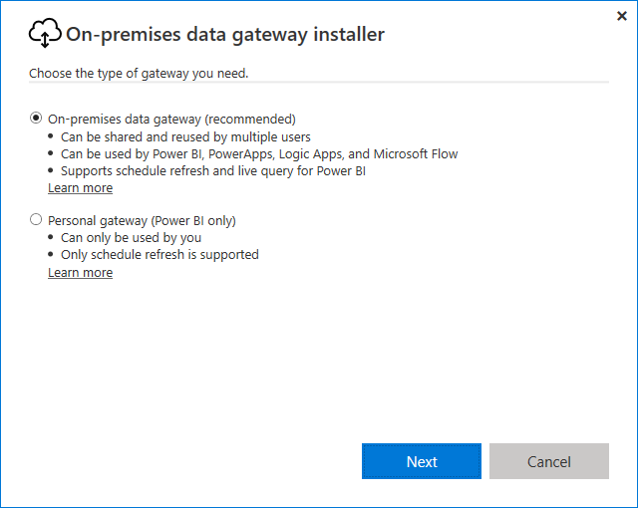
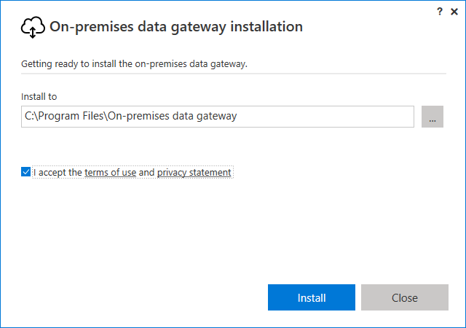
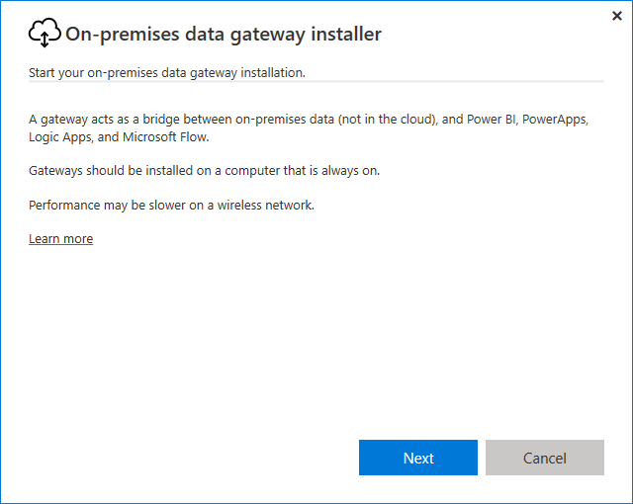
On-Premises Gateway Installation

Slide 31
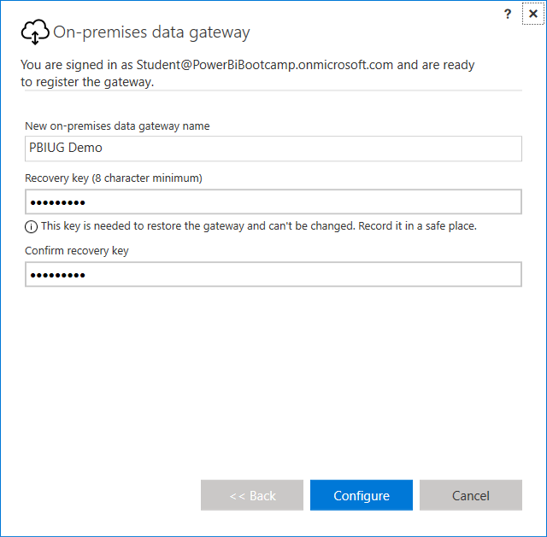
On-prem Gateway Names & Recovery Keys

Slide 32
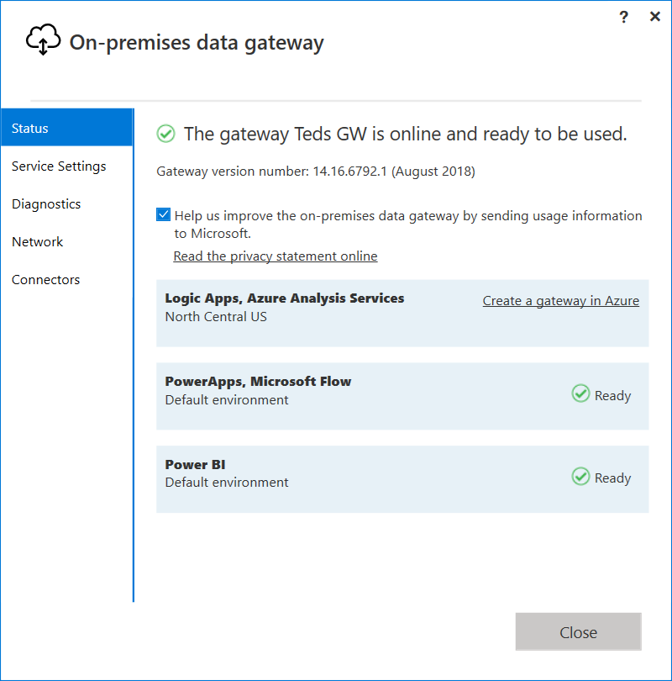
Getting the Gateway Up and Running

Slide 33
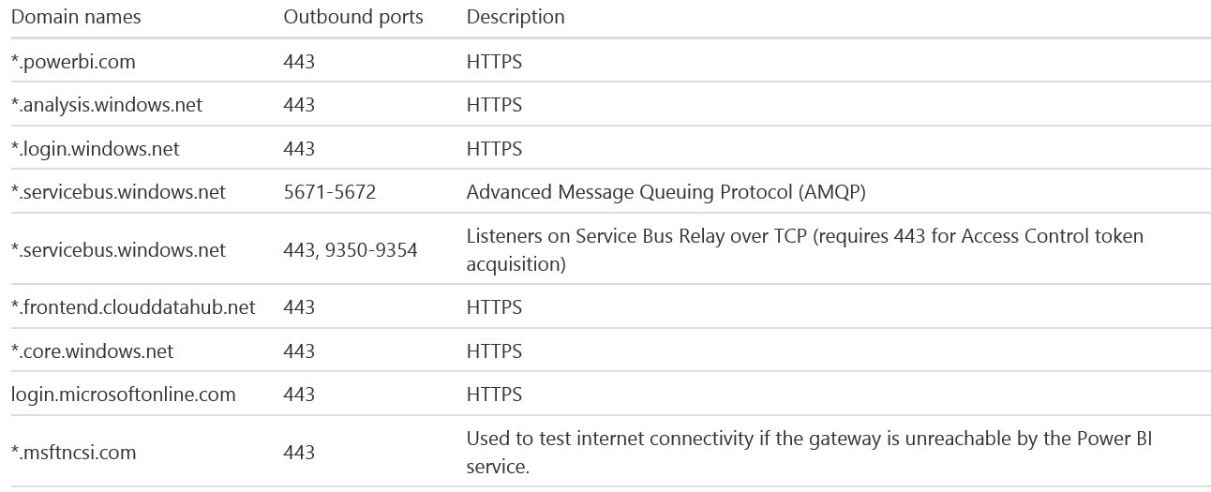
Outbound Ports – On-Premises Gateway
Gateway communicates through outbound ports
Gateway does not require inbound ports

Slide 34
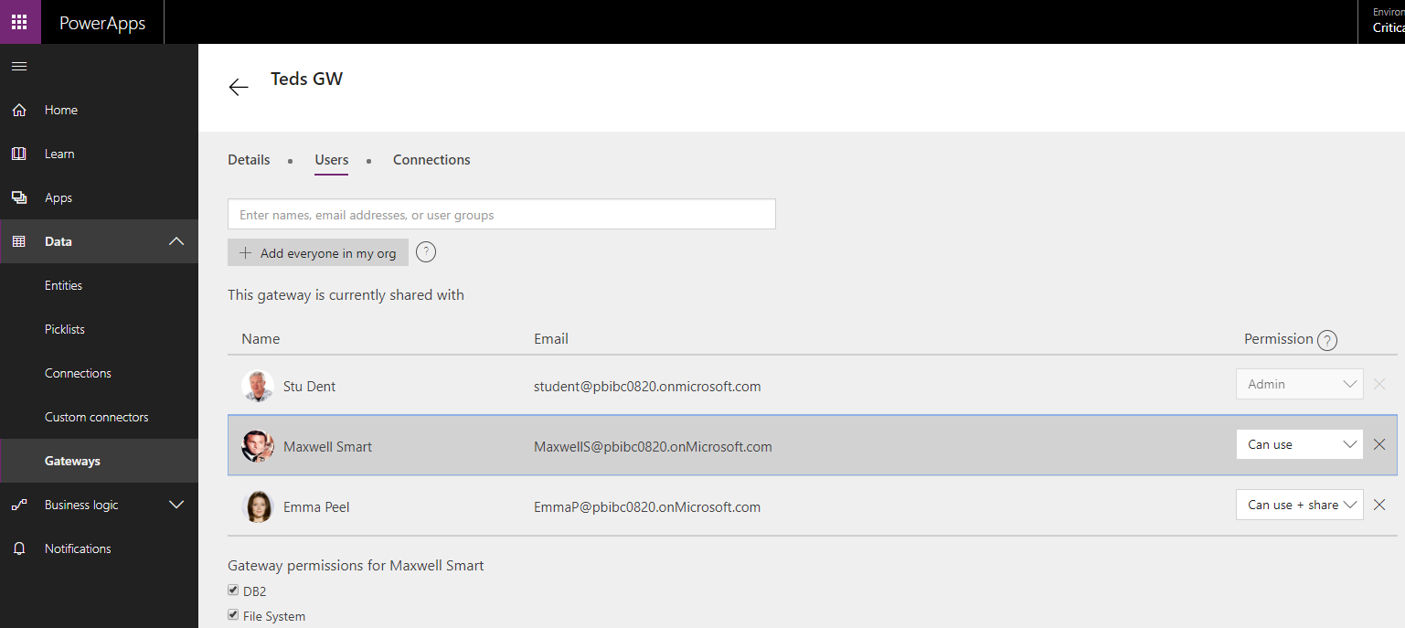
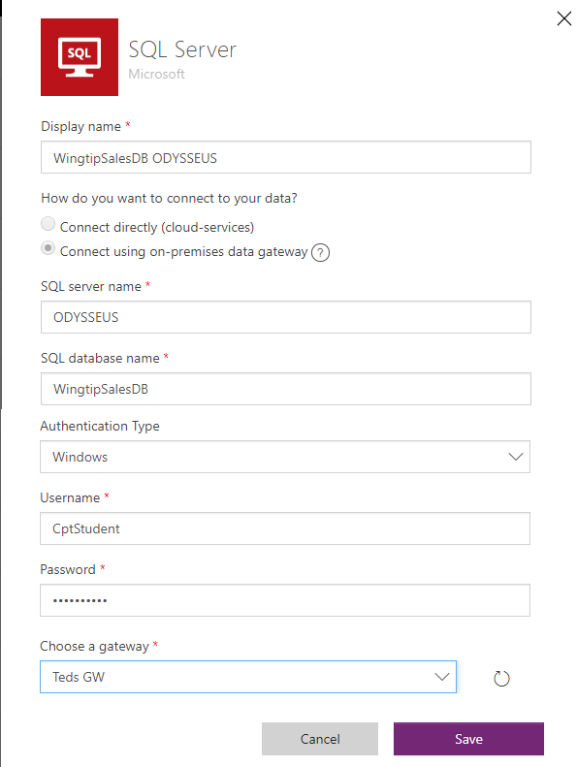
Using a Gateway to Create a Connection

Slide 35
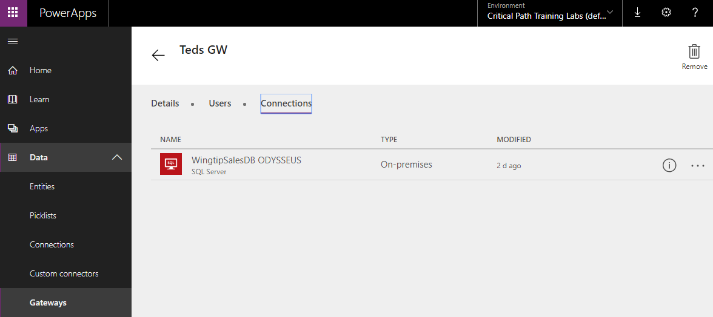
On-Premises Data Gateway
On-Premises Gateway required to access on-premises data
Gateway used by Power BI, PowerApps, Flow and Logic Apps
Download installer: http://go.microsoft.com/fwlink/?LinkID=820931

Slide 36
Agenda
Understanding Environments
Configuring Data Loss Prevention Policies
Sharing and Versioning Canvas Apps and Flows
Exporting and Importing Canvas Apps and Flows
Installing and Configuring an On-Premises Data Gateway
Packaging and Deploying Custom Solutions

Slide 37
Introduction to Solutions
Solutions used to move configuration between environments
Solutions used to move metadata (e.g. custom entity, model-driven apps)
Solutions not used to move business data itself
Solutions can be managed or unmanaged
Unmanaged solutions is "open" solution which allows changes
Managed solutions are locked down and do not allow changes.
During development, you work with an unmanaged solution
When you export solutions, export is created as managed or unmanaged
When you import a managed solution, it is in lockdown mode
You cannot modify or remove application components or customization
Managed solution is serviceable and upgradable
Uninstalling managed solution removes everything

Slide 38
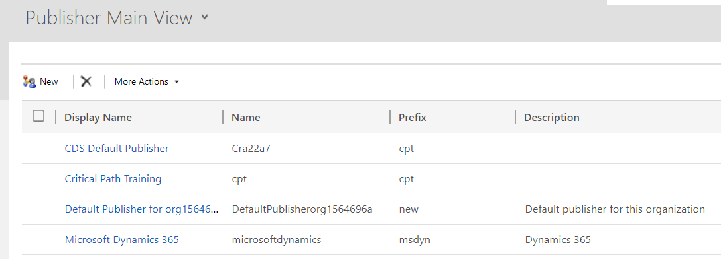
Publishers and Solutions
CDSA solutions used to distribute applications
Provides means to conduct ALM
CDSA Publishers
Profile used to provide identity for CDSA solutions
You should create new publisher when distributing solutions

Slide 39
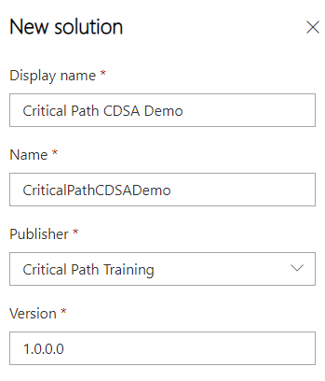
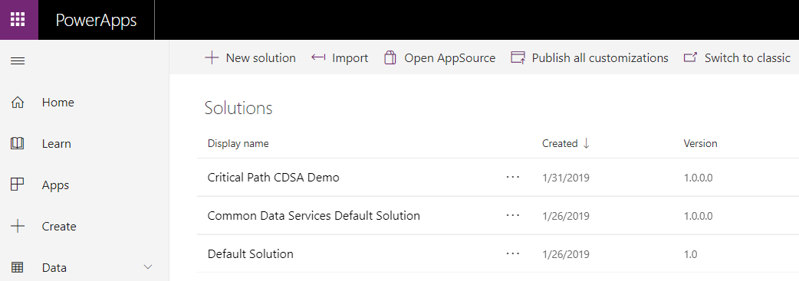
Creating a New CDSA Solution

Slide 40
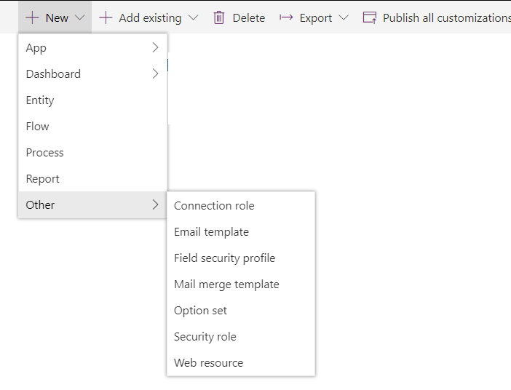

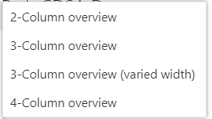
Adding Solution Components

Slide 41
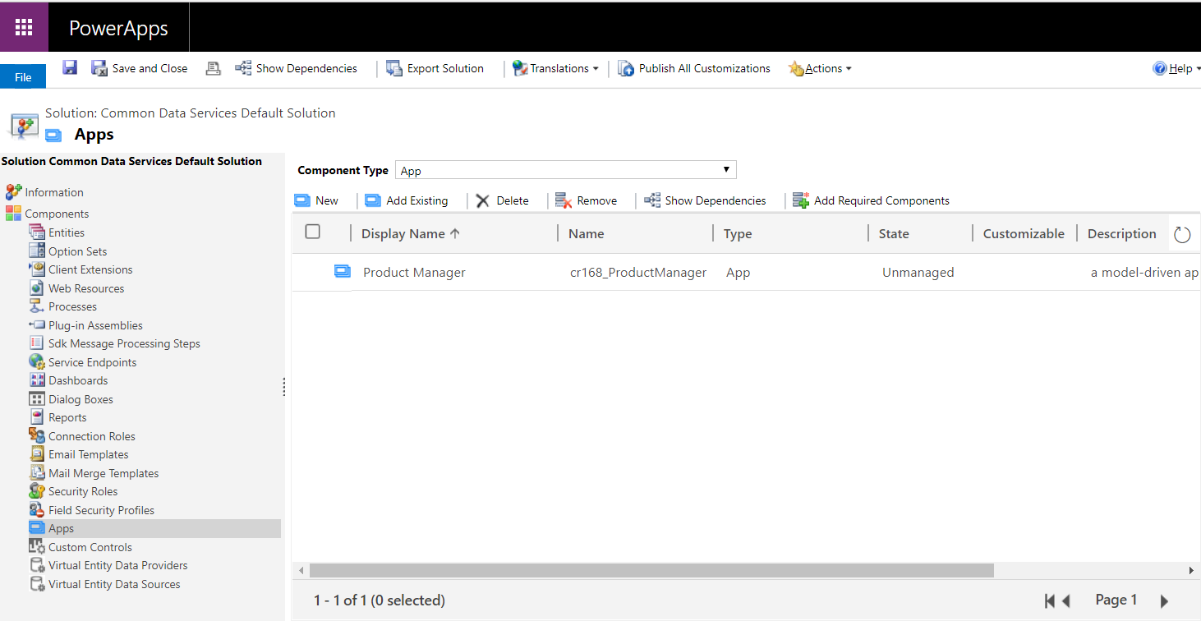
Solution Explorer
Solution Explorer provides top-level view of customizations
Can be challenging to find in current UI experience

Slide 42
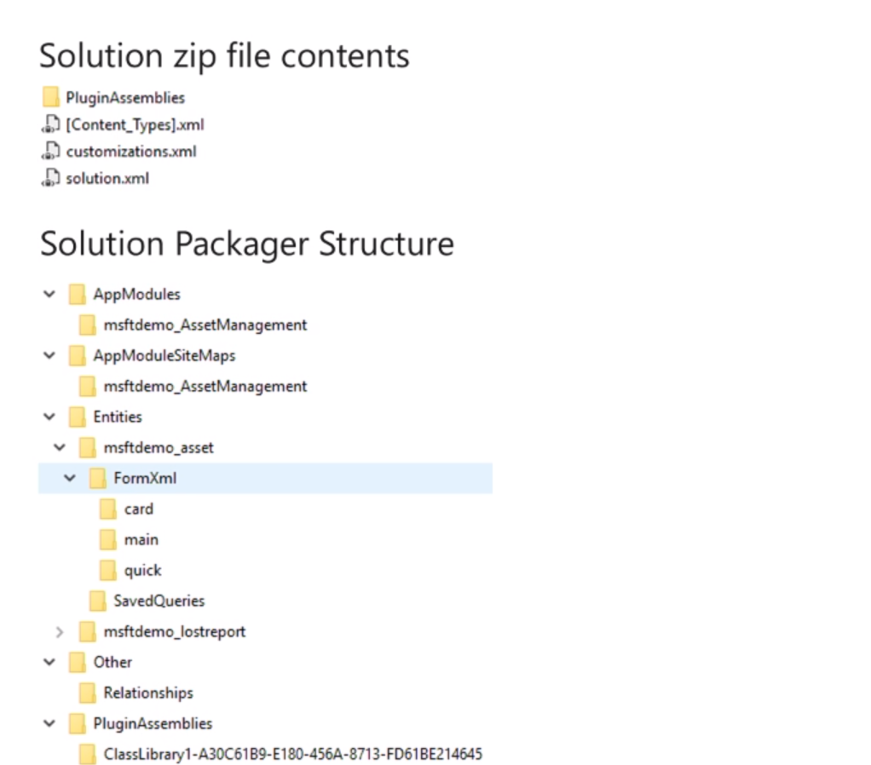
Solution Packager
Used to store the solution zip components in organized folder structure
Make source control and differencing much easier
Allows for both unmanaged and managed files to be in source control

Slide 43
Installing Solutions
Solutions can depend on other solutions
You can't install solution until you install dependencies
How do you install solutions?
Solution Manager
Package Deployer tool
Package deployer tool
can be run interactively
can be run from PowerShell
can be run by installing from AppSource marketplace

Slide 44
Installing Unmanaged Solutions
When you import an unmanaged solution…
changes merged in with other unmanaged changes
Unmanaged solutions cannot be removed as a unit
Merged changes removed by manually removing items
administrator must publish unmanaged changes to have any non-schema (e.g. display labels) changes be visible to other users

Slide 45
Summary
Understanding Environments
Configuring Data Loss Prevention Policies
Sharing and Versioning Canvas Apps and Flows
Exporting and Importing Canvas Apps and Flows
Installing and Configuring an On-Premises Data Gateway
Packaging and Deploying Custom Solutions

